Slide 1


IRONHACK PAYMENTS CASE
GERARD ROCA

Slide 2
IRONHACK PAYMENTS CASE
What do we want to find?
Frequency of Service Usage:
Incident Rate
Revenue Generated by the Cohort
New Relevant Metric

Slide 3
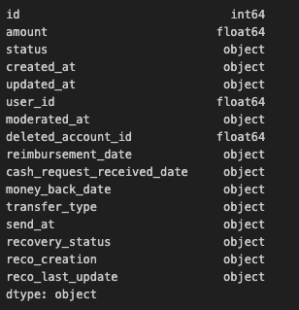
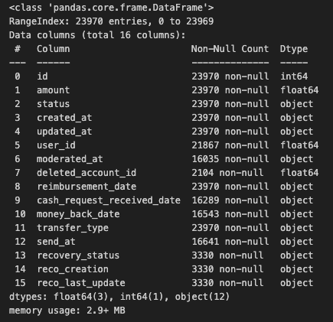
IRONHACK PAYMENTS CASE
What is the process?
Import libraries
Import .csv (cash & fees)
Data treatment: cohort by month & empty cells
Merged DF
Visualization on VSC

Slide 4
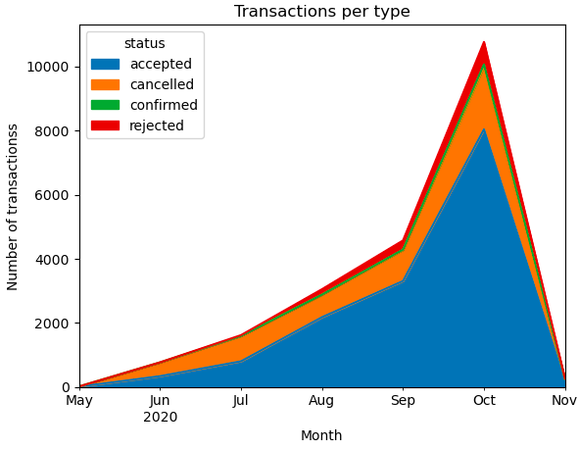
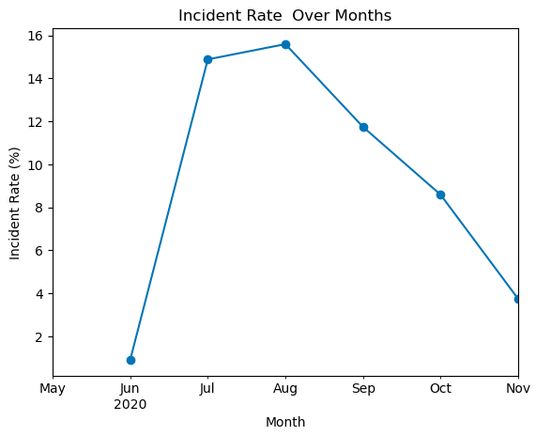
IRONHACK PAYMENTS CASE
INSIGHTS 1/2
TRANSACTIONS ARE INCREASING
INCIDENTS ARE DECREASING

Slide 5
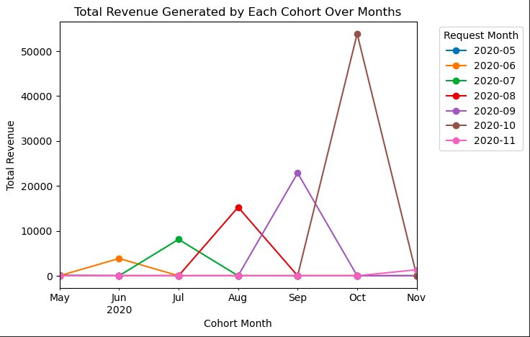
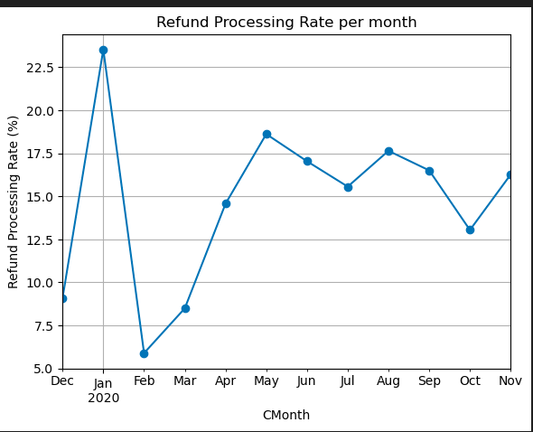
IRONHACK PAYMENTS CASE
INSIGHTS 2/2
POSITIVE TENDENCE OVER MONTHS
LESS COMPLETED REFUNDS

Slide 6
THANK YOU!

